Slide 1
SPAN Image Analytics Update
Ryan Cabeen
August 27, 2020

Slide 2
Progress Update – Data in the LONI IDA
Sites:
Hopkins
12 scans uploaded in total
Yale
8 scans uploaded in total
Augusta
4 scans uploaded
U. of Iowa
11 scans uploaded
UT
1 scan uploaded
Totals
36 scans with 33 conforming
2 oddballs (usable)
3 localizers (unusable)

Slide 3
Analytics Pipeline Overview
IDA
Image Collection
Download
Image Preprocessing: Conversion and Harmonization
Parameter Estimation:
Estimate maps of ADC & T2
Image Segmentation and Statistical Summary
Analytics Report and Visualizations

Slide 4
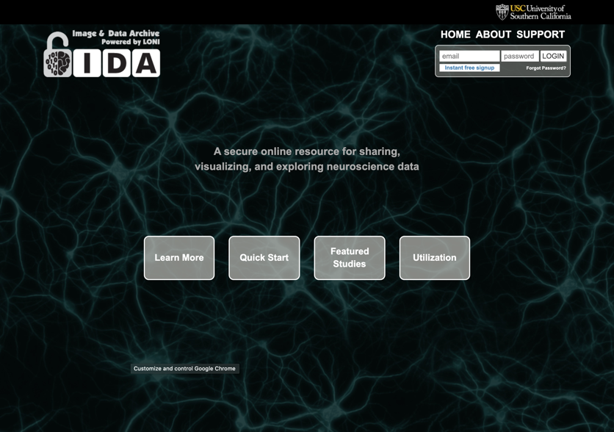
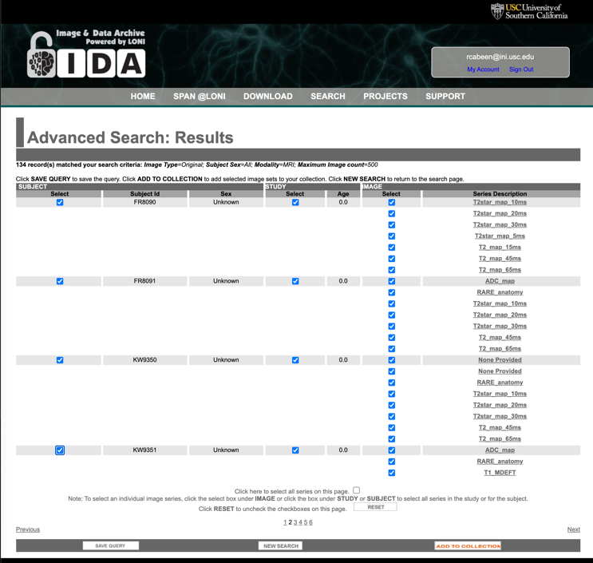
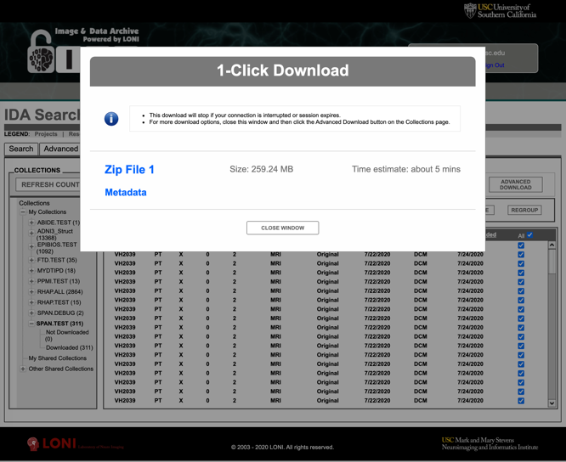
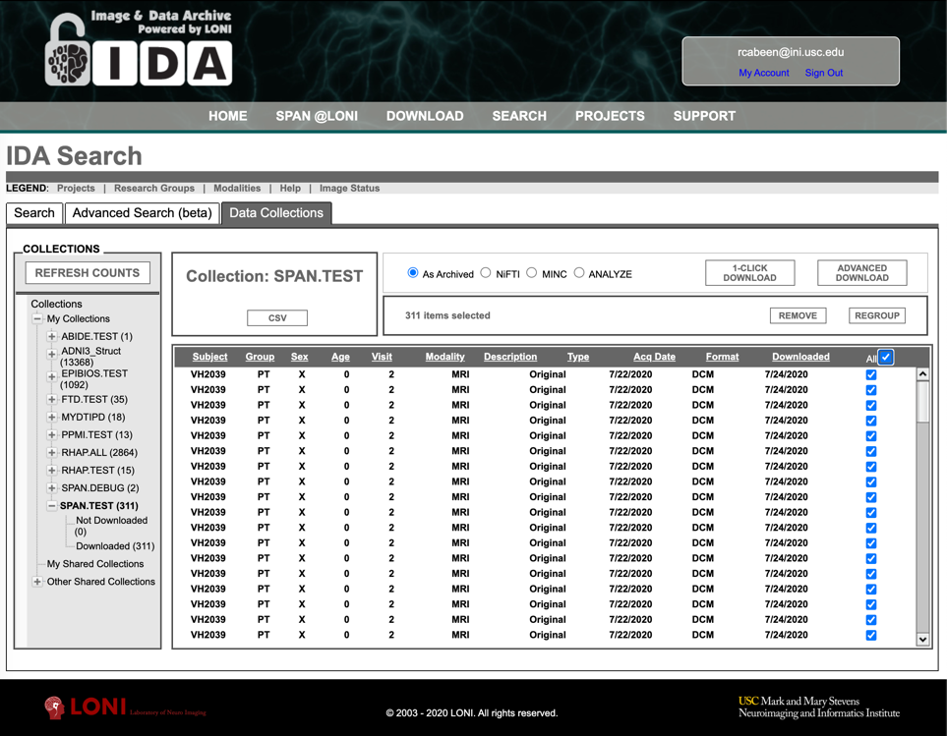
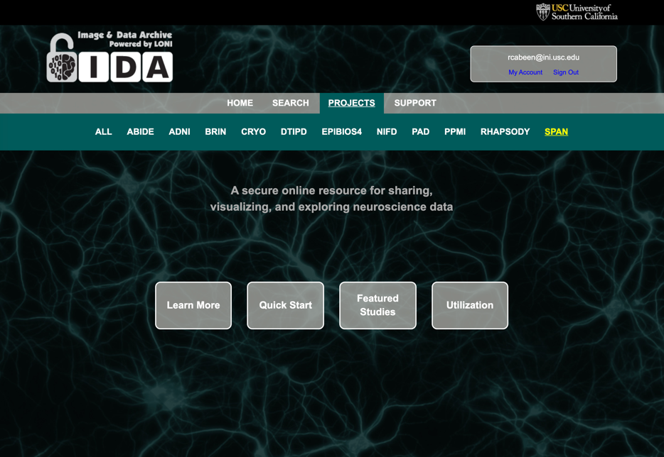
LONI IDA Data Wrangling Process
Download
Query
Login
Next steps…
Collect

Slide 5
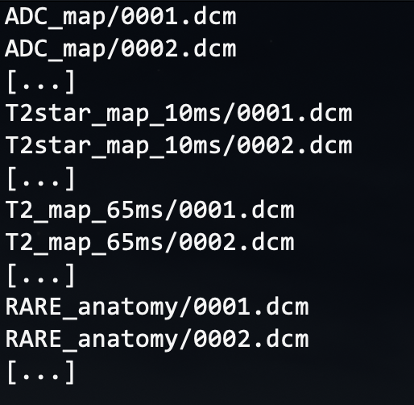
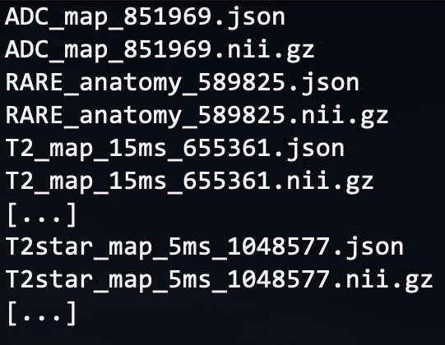
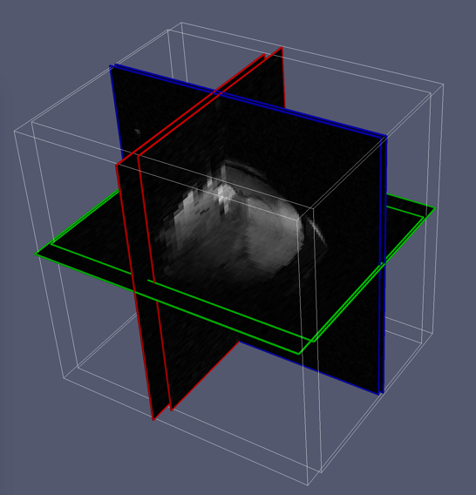
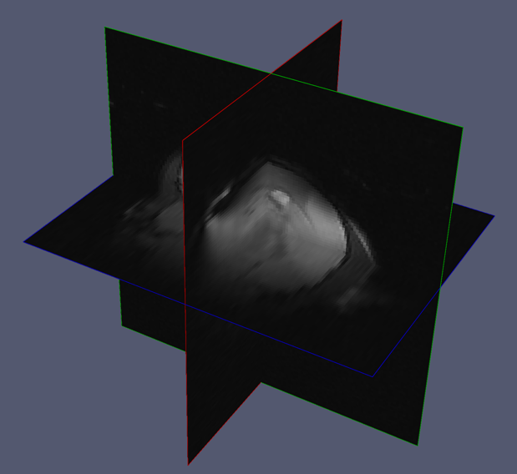
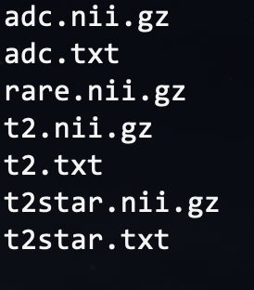
Image Preprocessing
File Format Conversion
DICOM to NIfTI
Extract
Meta-data (site & scan parameters)
Harmonize
3D Image orientation and resolution
Collect, Sort and Harmonize Scans
…
(note: DICOM names shortened for clarity)
(some sites use a different FOV within a single session)
(we harmonize the data to remove these differences)

Slide 6
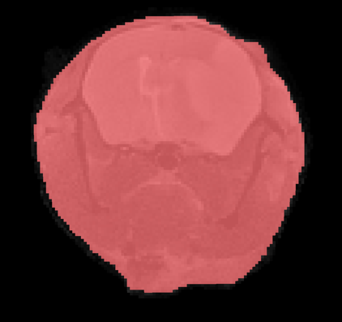
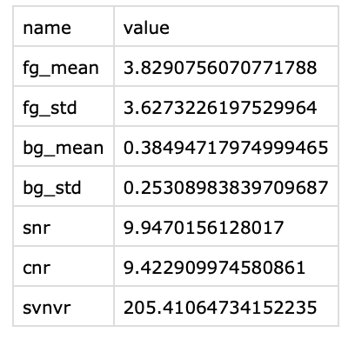
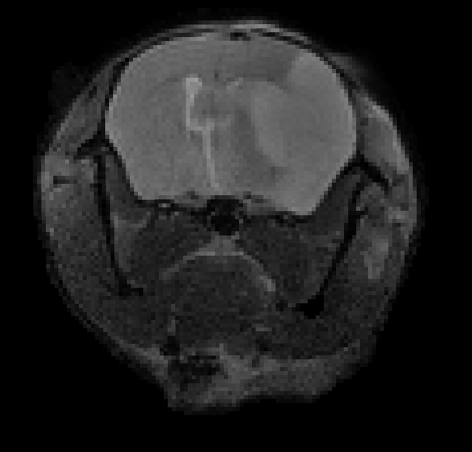
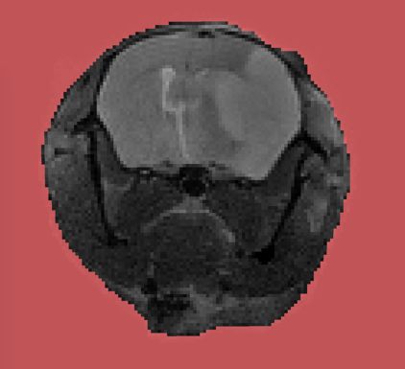
Quality Assessment
Foreground
Metrics
Background
Input Scan
(repeat for ADC, T2, T2-star)
SNR= μ_{FG} / μ_{BG}
CNR= σ_{FG} / μ_{BG}
SVNVR= σ_{FG} / σ_{BG}
Signal Mean (μ) and Std. Deviation (σ) of Foreground (FG) and Background (BG)

Slide 7
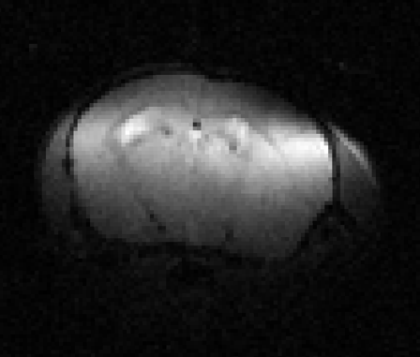
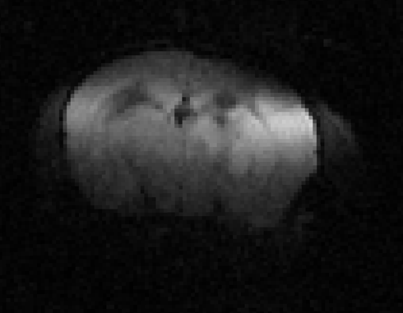
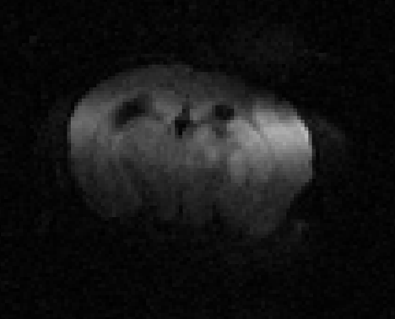
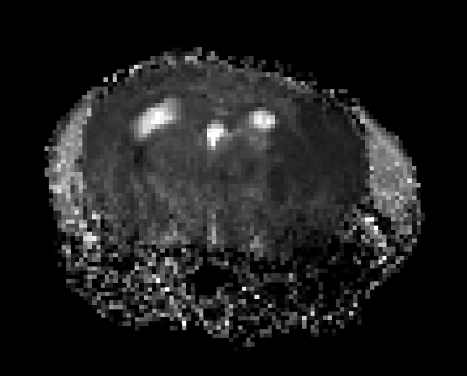
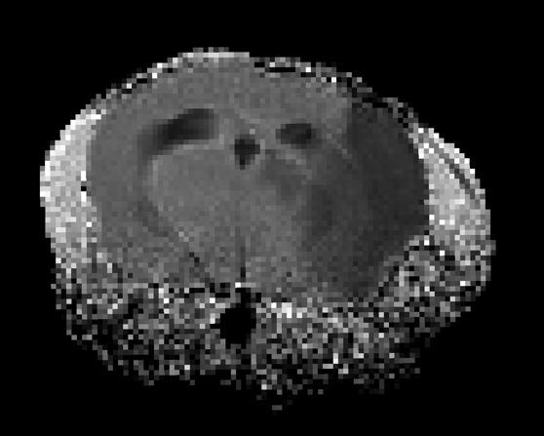
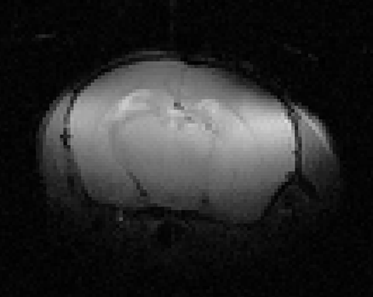
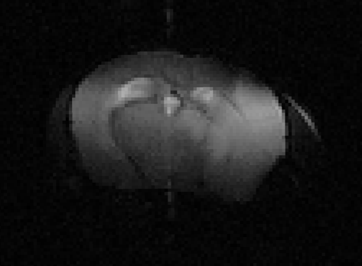
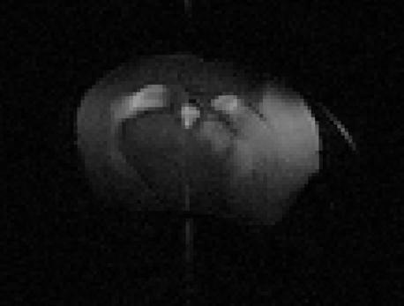
Parameter Estimation
Estimating the Apparent Diffusivity Coefficient (ADC) from multiple b-values
Fitting
b=0 s/mm²
b=500 s/mm²
b=1000 s/mm²
ADC
Estimating the T2 Relaxation Rate from multiple echo times
Fitting
TE=15ms
TE=45ms
TE=60ms
…
T2

Slide 8
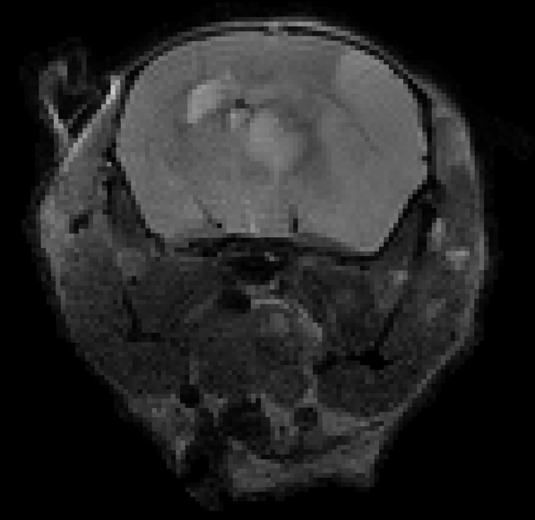
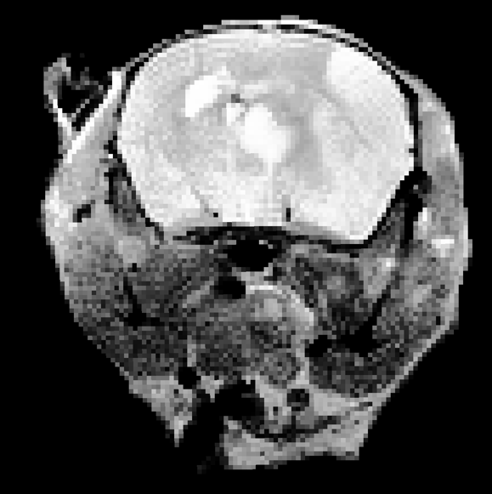
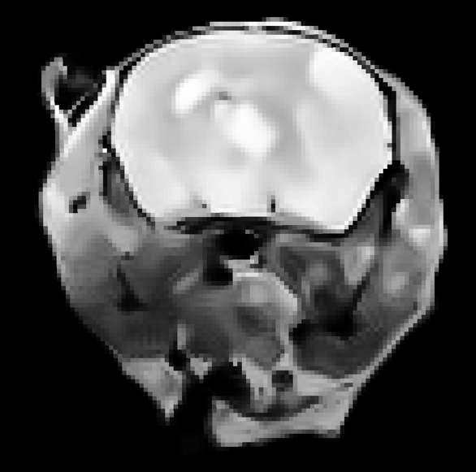
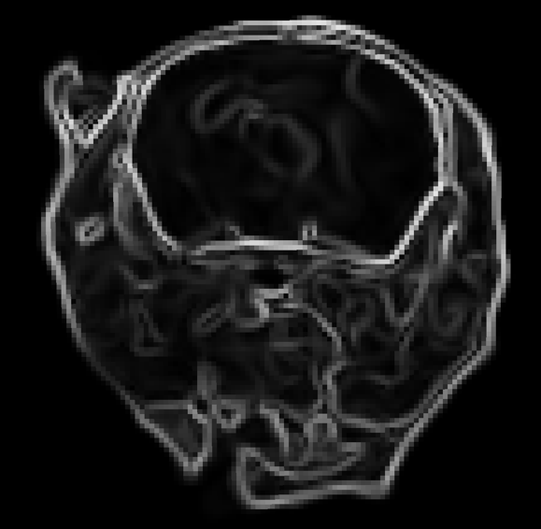
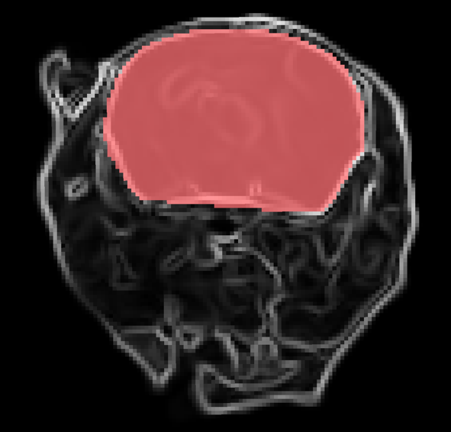
Brain Extraction
Input Scan
Enhanced Contrast
Regularized
Gradients
Brain Segmentation
Approach:
Avoid atlas registration and instead use feature extraction and graph-based segmentation

Slide 9
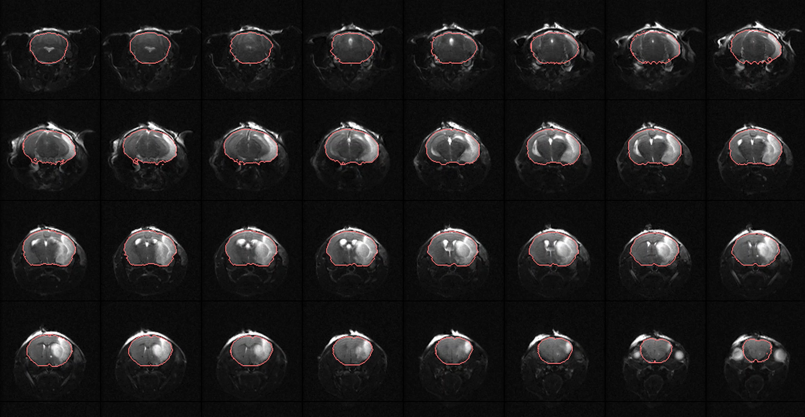
Brain Extraction

Slide 10
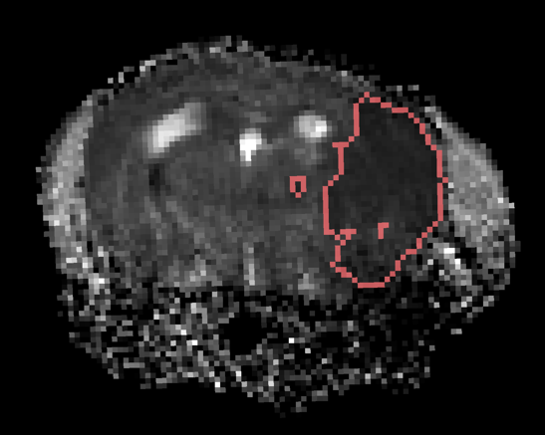
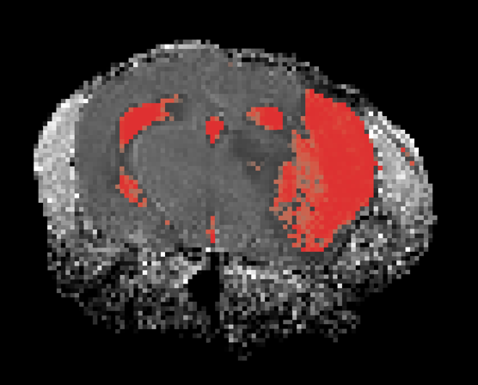
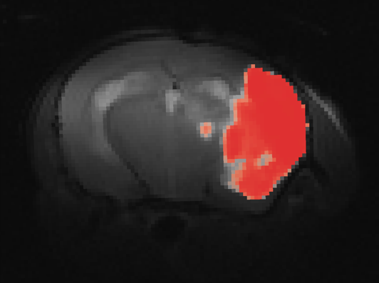
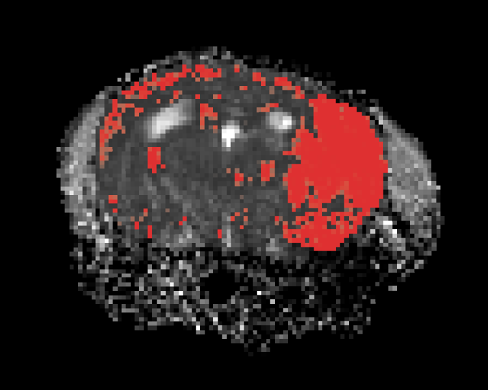
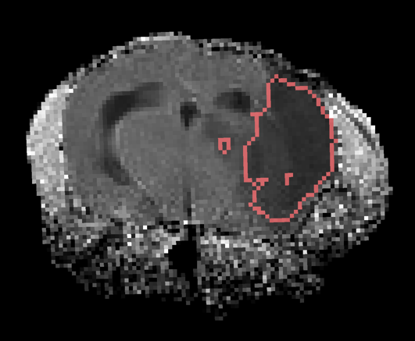
Lesion Segmentation
ADC
Intensity
Normalization
Probabilistic
Thresholding
Region
Extraction
T2
Combining Information from Multiple Contrasts

Slide 11
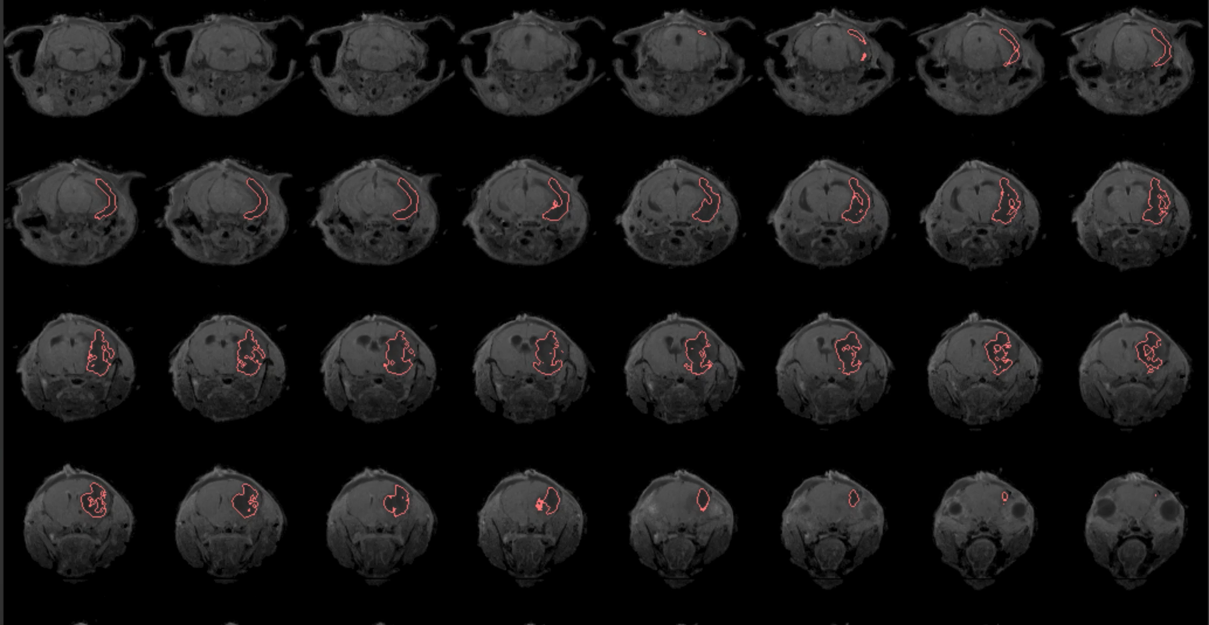
Lesion Segmentation

Slide 12
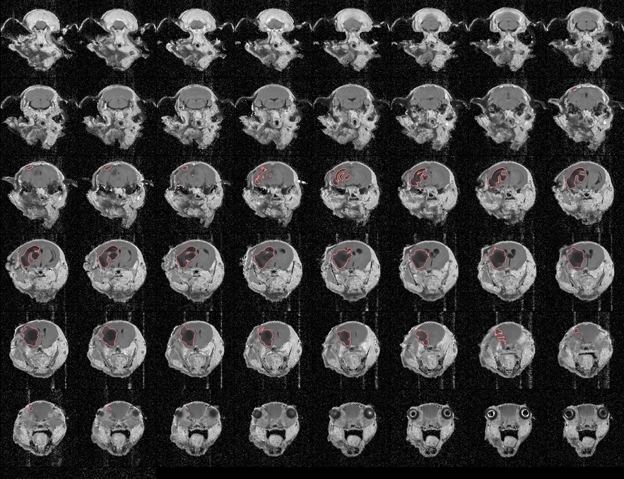



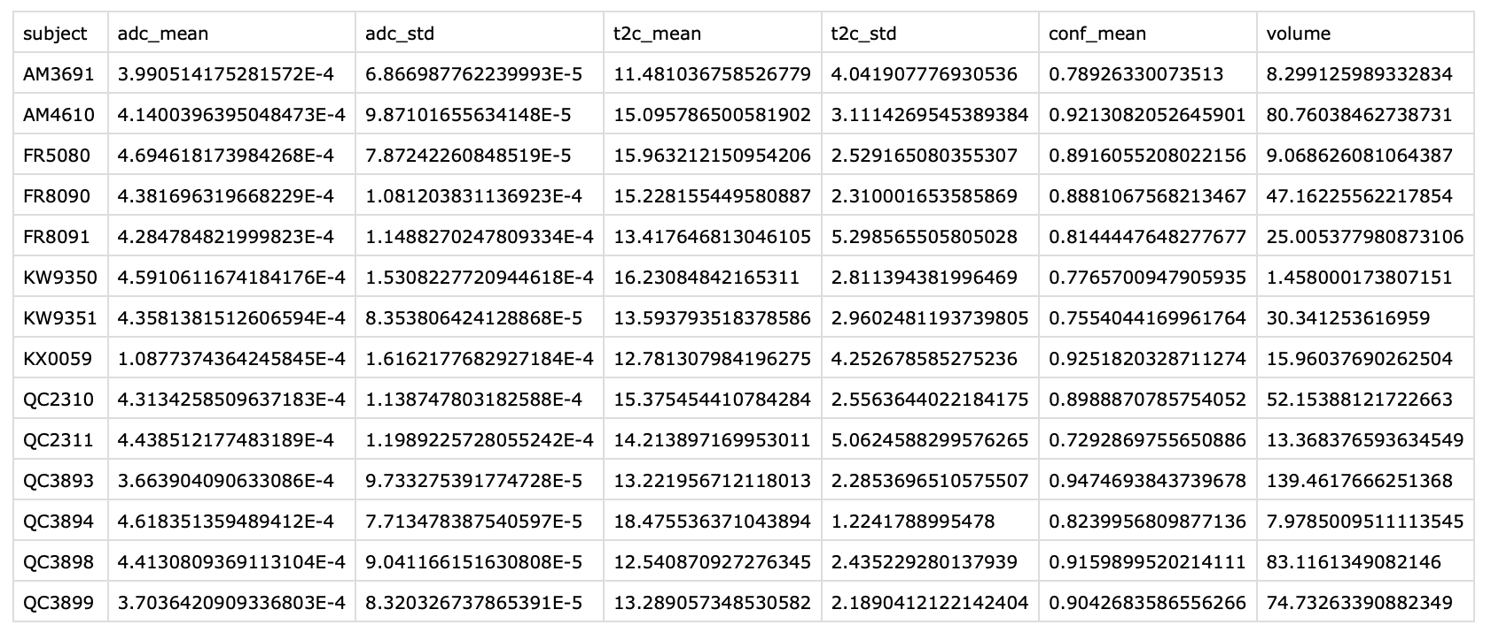
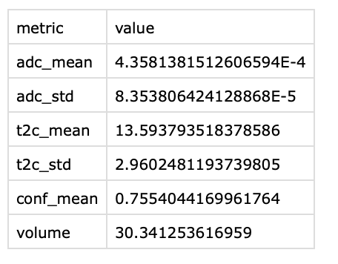
Analytics and Report Generation
Mosaic Plots
T2
ADC
Single Scan
Report of Imaging Metrics for Entire Cohort
Imaging Metrics for an Individual
Aggregate data with other all individuals

Slide 13
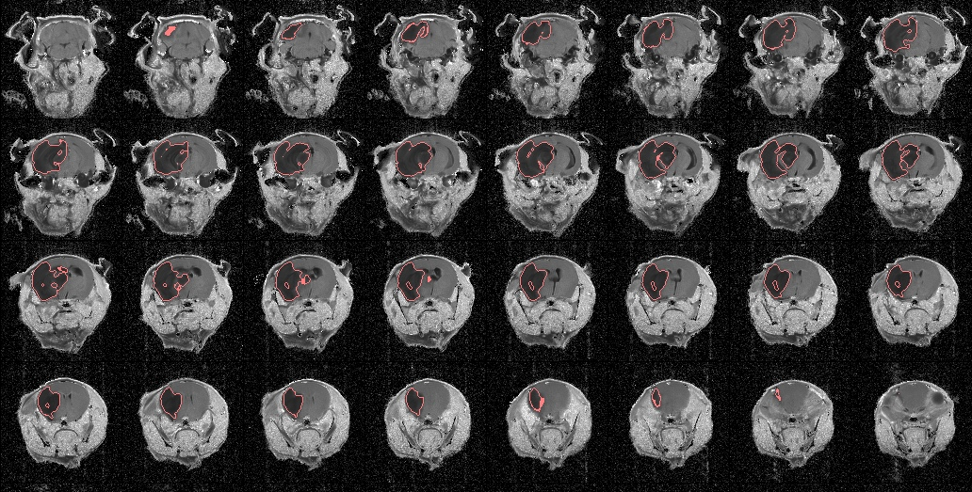
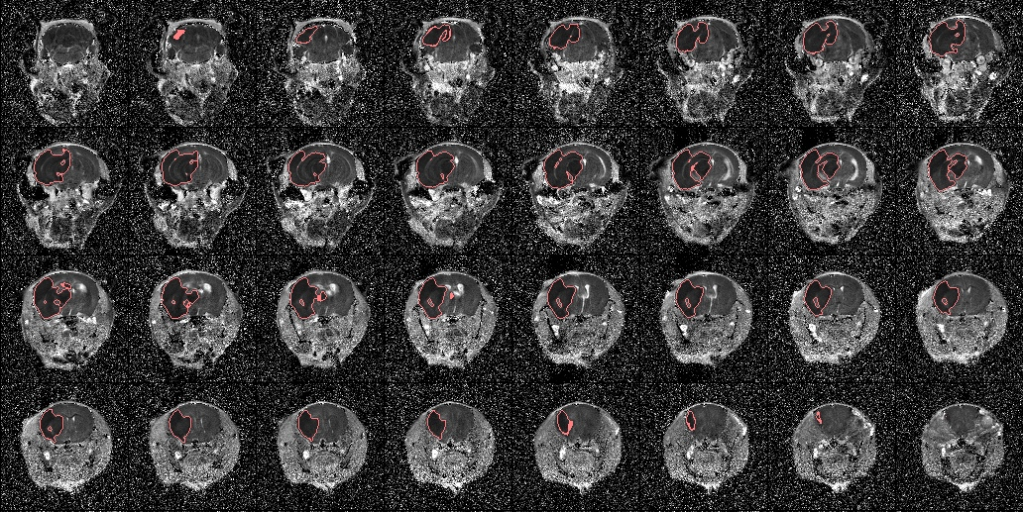
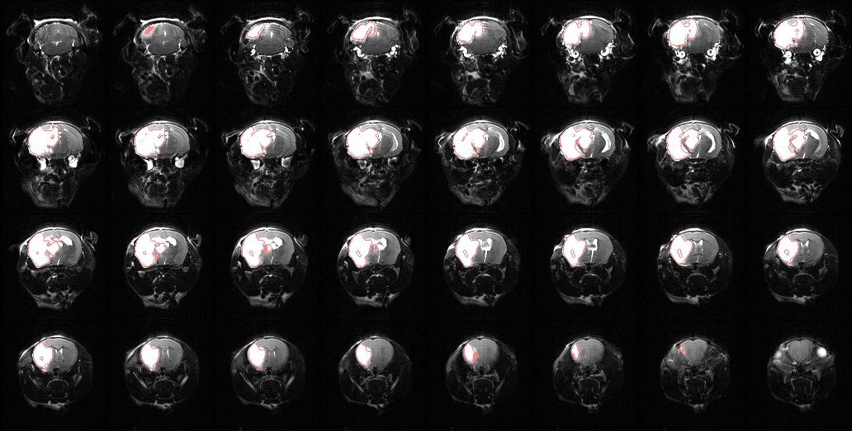
Some Results Hopkins QC3893
T2
ADC
RARE

Slide 14
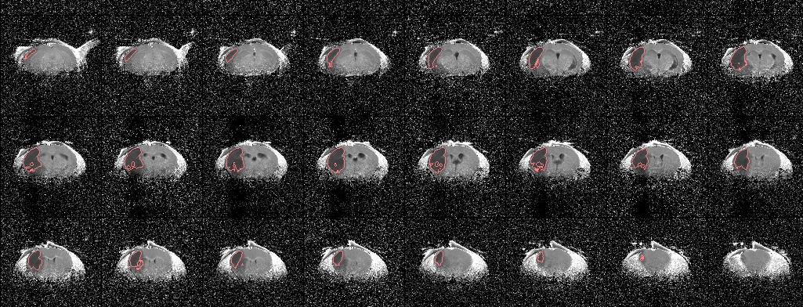
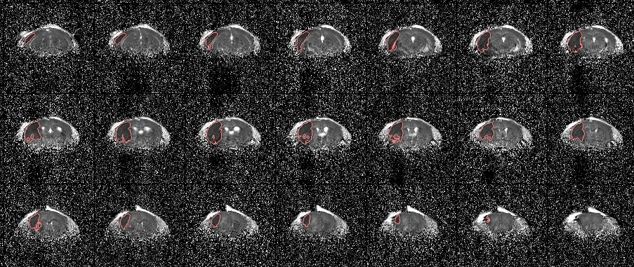
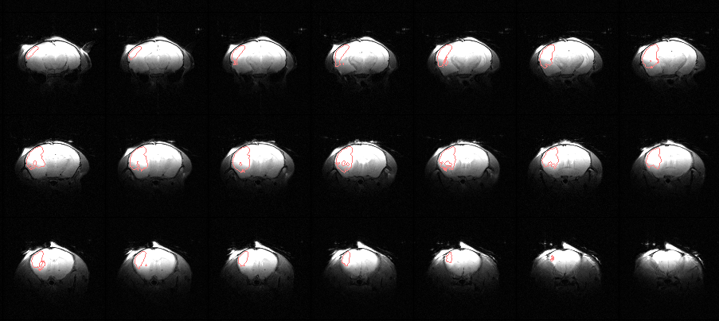
Some Results Yale FR8090
T2
ADC
RARE

Slide 15
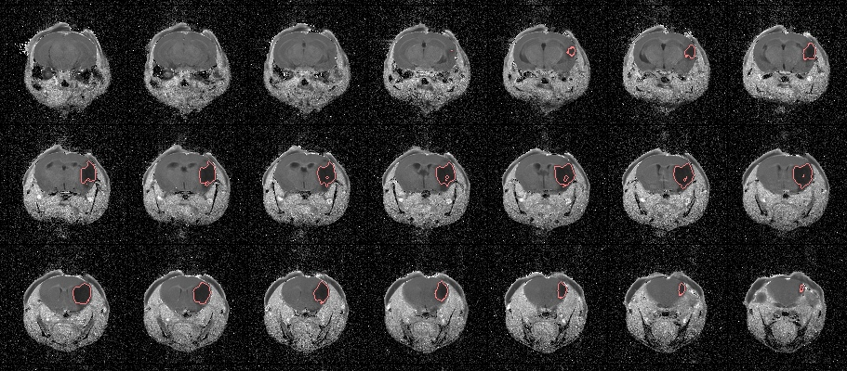
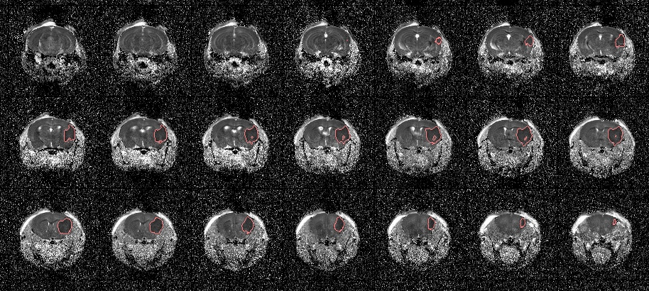
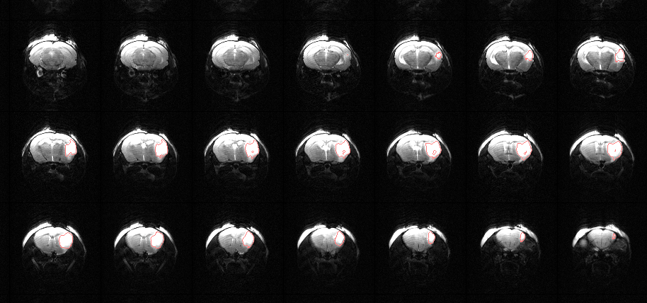
Some Results UT UT0002
T2
ADC
RARE

Slide 16
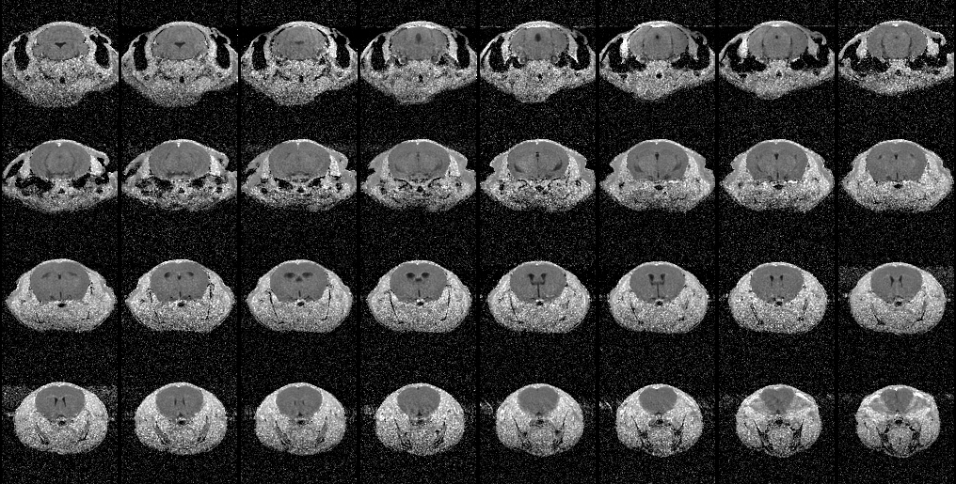
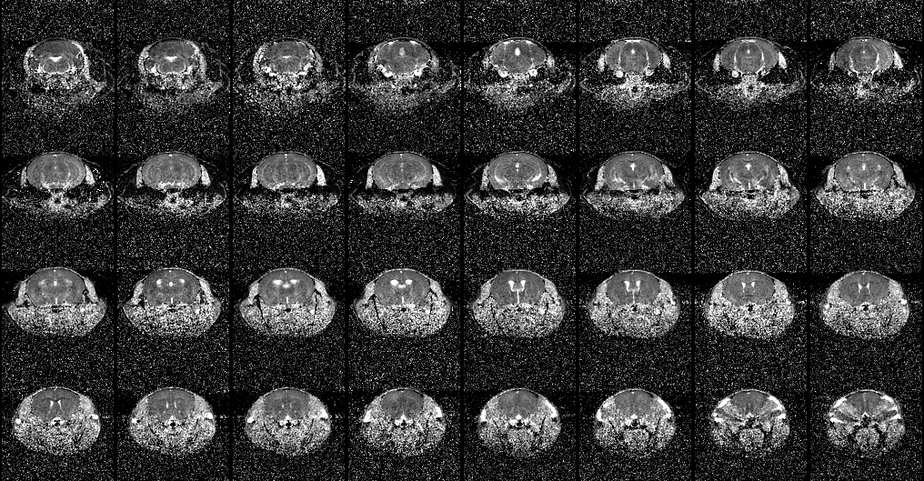
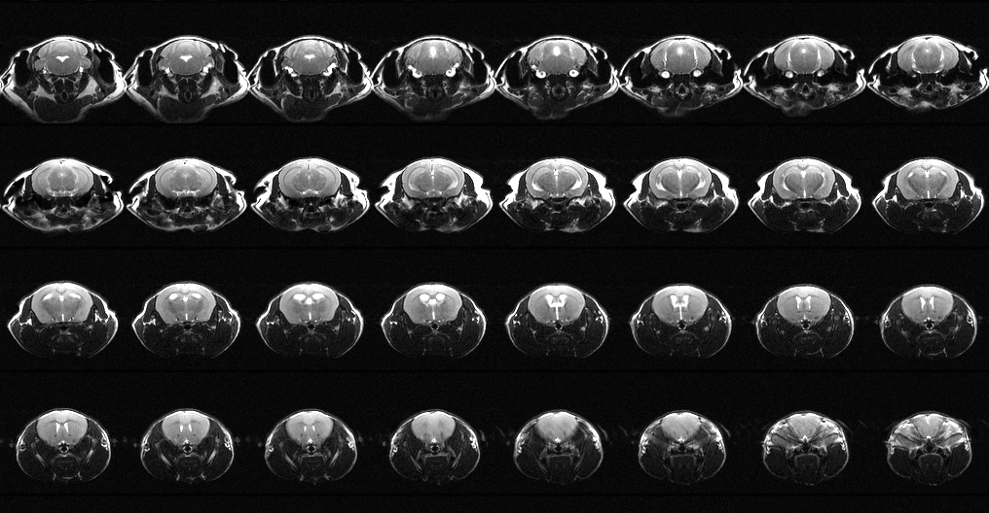
Some Results U of Iowa UI0000 (no lesion?)
T2
ADC
RARE

Slide 17
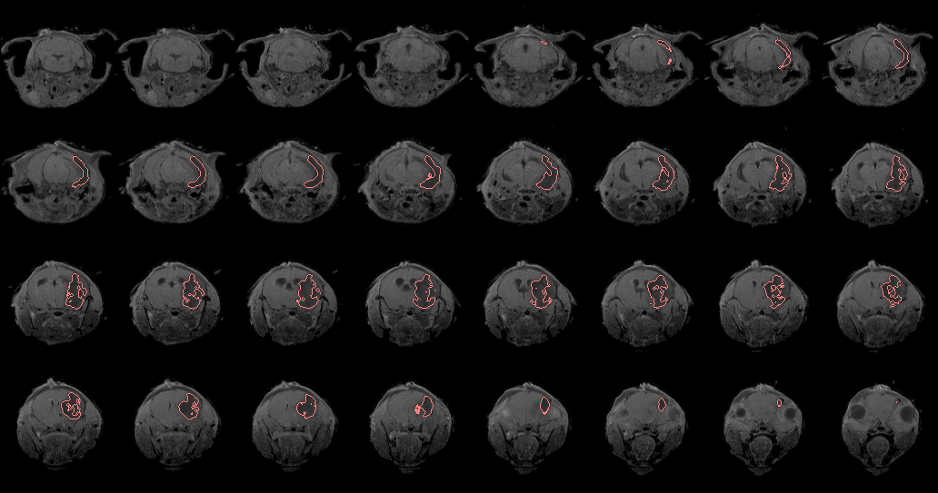


Some Results Augusta AU8051
T2
ADC
RARE

Slide 18
Statistical Results – Quality Assessment

Slide 19
Statistical Results – Parameter Mapping

Slide 20
Statistical Results – Parameter Mapping
Challenge: inter-site differences in ADC and T2 by tissue type make thresholding hard (see red line)

Slide 21
Statistical Results – Parameter Mapping
Solution: ADC and T2 harmonization to make thresholds comparable

Slide 22
Raw Parameters
Harmonized Parameters

Slide 23
Statistical Results – Volumetrics

Slide 24






Updates on previous issues
Motion Issue
T2
We can extract echo times from image headers
Intra-session motion is a minor possibility (only one so far)
In-homogeneity may present a systematic issue to address
Upload issues for have been resolved (Yale and UIowa)
IDA changes to change DICOM tag handling
Analytics update to use scan information from either ProtocolName and SeriesDescription DICOM tags
ADC
RARE
T2
ADC
RARE
In-homogeneity Issue

Slide 25


Remaining Pieces
Midline Shift
Possible solution: segment vessels and measure deviation from the brain mask midline axis
Hemispheric tissue volume
Possibly combine with midline shift detection
T2-star
Susceptibility artifact depends on echo time
Algorithm Refinement
Create validation dataset and optimize parameters

